Slide 1
Operating System: System Software

Slide 2
The OS
Controls computer functions
Hardware
Processor
Memory
Devices
Provides means for software to work with the CPU
Responsible for management, scheduling, and interaction of tasks
Provides user interface
Notes:
System software consists of two primary types of programs: the operating system and utility programs.
The operating system (OS) is the main program that controls how your computer system functions. The OS manages the computer’s hardware, including the processor, memory, and storage devices, as well as peripheral devices. The operating system also provides a consistent means for software applications to work with the CPU. Additionally, it is responsible for the management, scheduling, and interaction of tasks. Your first interaction with the OS is the user interface.

Slide 3
System Software: Utilities
Utilities: Programs that perform computer housekeeping tasks
Manage system resources
Improve efficiency
Virus prevention
Notes:
System software also includes utility programs. These are small programs that perform many of the general housekeeping tasks for the computer, such as system maintenance and file compression.

Slide 4
Operating System Categories
Four categories:
Real-time (RTOS)
Single-user, single-task
Single-user, multitask
Multiuser
Notes:
Operating systems can be classified into four categories, depending on the number of users they service and the tasks they perform.
Real-time operating systems don’t require the intervention of any users at all.
Single-user, single-task operating systems are proprietary systems developed specifically for the devices they manage.
Single-user, multitask operating systems are available commercially for personal and business use.
Multiuser operating systems coordinate resources for many users on a network.

Slide 5
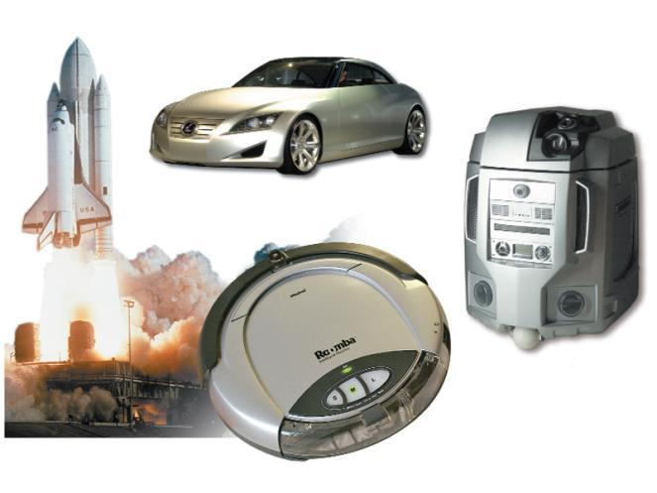
Real-Time Operating Systems
Systems with a specific purpose and a certain result
Uses include:
Industrial machines
Robotic devices
Automobiles
Video game consoles
Home appliances
Notes:
Machinery that performs a repetitive series of specific tasks in an exact amount of time requires a real-time operating system.
This type of operating system is a program with a specific purpose.
For example, instruments such as those found in the scientific, defense, and aerospace industries that must perform regimented tasks or record precise results require real-time operating systems.
Real-time operating systems are also found in many types of robotic devices, fuel-injection systems in car engines, video game consoles, and home appliances.
Real-time operating systems require minimal user interaction. The programs are written specifically to the needs of the devices and their functions. Therefore, there are no commercially available standard RTOS software programs.

Slide 6
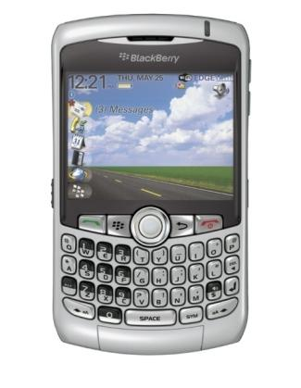
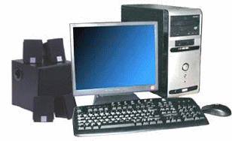
Single-User Operating Systems
Single-task systems
Perform one task at a time
PDAs:
Pocket PC
Palm OS
Windows Mobile
MS-DOS
Multitask systems
Perform simultaneous tasks
Windows
Mac OS
Linux
Notes:
All computers on which one user performs just one task at a time require a single-user, single-task operating system. PDAs currently can perform only one task at a time by a single user, so they require single-user, single-task operating system software such as Windows Mobile and Palm OS.
Microsoft Disk Operating System (MS-DOS) is another example of a single-user, single-task operating system.
Because most home computers can handle only one person working on it but can perform a variety of tasks simultaneously, they use a single-user, multitask operating system. Windows operating systems and the Macintosh operating system (Mac OS) are most commonly used as single-user, multitask operating systems.

Slide 7
Multiuser Operating Systems
Known as network operating systems
Allow access to the computer system by more than one user
Manage user requests
Systems include:
Linux
UNIX
Unicos
Windows Server 2008
Windows Vista
Mac OS X
i5/OS
z/OS
Notes:
A multiuser operating system (also known as a network operating system) enables more than one user to access the computer system at one time by efficiently juggling all the requests from multiple users.
Networks require a multiuser operating system because many users access the server computer at the same time and share resources. A network operating system is installed on the server and manages all user requests, ensuring that they do not interfere with each other.
Examples include Linux, UNIX, Unicos (an offshoot of Unix), Windows Server 2008, i5/OS, and z/OS.
Windows Vista and Mac OS X can also be considered multiuser operating systems because they allow the creation of home networks without any additional operating systems being needed.

Slide 8
Desktop and Notebook Operating Systems
An operating system combined with a processor is known as a platform.
Microsoft Windows/Intel
Apple Macintosh/Motorola
Desktop and notebook operating systems include:
Microsoft Windows
Mac OS
Linux
UNIX
Notes:
The combination of operating system and processor is referred to as a computer’s platform.
For example, Microsoft Windows operating systems are designed to coordinate with a series of processors from Intel Corporation and AMD (Advanced Micro Devices) that share the same or similar sets of instructions. Until recently, Apple Macintosh operating systems worked primarily with processors from Motorola and IBM designed specifically for Apple computers. Apple has recently adapted the Intel processor.
Apple’s use of the Intel processor and a utility called Boot Camp offers the ability to utilize both the Windows and Mac OS simultaneously.
The three most used desktop operating systems are Windows, Mac OS, and Linux.

Slide 9
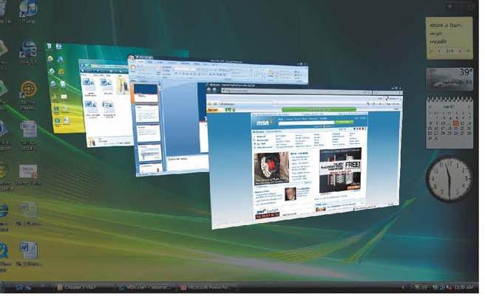
Microsoft Windows
This newest version of Windows, which comes in many versions, provides tighter security and improved graphical capabilities.
Windows Vista (2007)
Notes:
Although Windows Vista is the most recent version of the Microsoft Windows operating system on the market, many computers still run earlier versions, such as Windows XP, Windows 95, Windows NT, Windows 98, Windows Millennium Edition (Me), and Windows 2000.
Windows Vista comes in a number of versions, including Windows Vista Home Basic, Windows Vista Home Premium, Windows Vista Business, Windows Vista Enterprise, and Windows Vista Ultimate.
Windows came under development soon after the Apple Macintosh introduced the graphical user interface in 1984. In fact, Microsoft was sued by Apple for stealing the “look and feel” of its operating system, a suit Apple eventually lost.

Slide 10
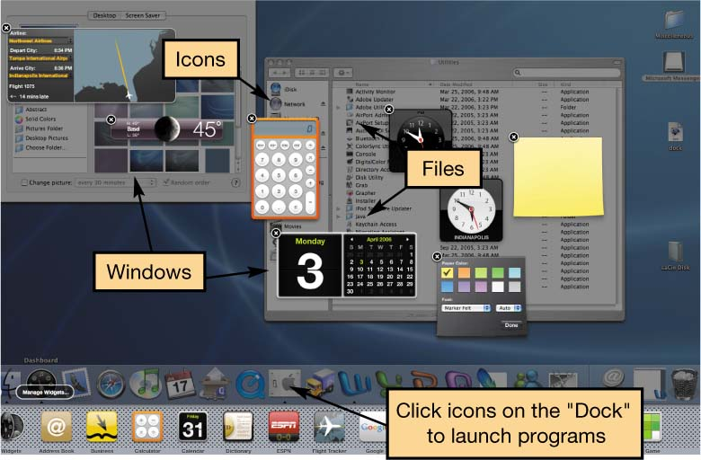
Mac OS
First commercially available OS with point-and-click technology (graphical user interface)
Excellent in:
Graphics display
Processing capabilities
System reliability
File backup utilities
Document recovery
Fewer software applications available than for Windows
Notes:
Although Apple’s Mac OS and the Windows operating systems are not compatible, they are similar in terms of functionality.
In 1984, the Mac OS became the first commercially available operating system to incorporate the user-friendly point-and-click technology in a commercially affordable computer. Both operating systems now have similar window work areas on the desktop that house individual applications and support users working in more than one application at a time.
Macs have long been recognized for their superior graphics display and processing capabilities. Users also attest to Mac’s greater system reliability, superior file backup utilities, and better document recovery.
However, there are fewer software applications available for the Mac platform than for the Windows platform, and Macs tend to be more expensive than Windows-based PCs.
The most recent version of the Mac operating system, Mac OS X, is based on the UNIX operating system.

Slide 11
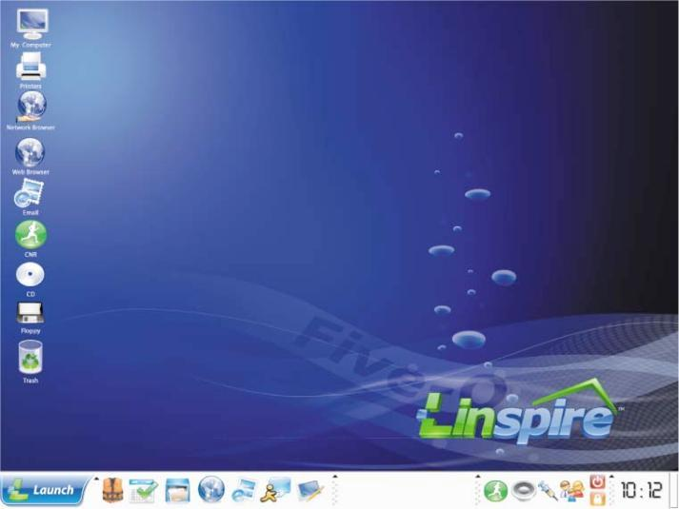
Linux
Open source operating system
Based on UNIX
Stable system
Free
May be downloaded from the Internet
Notes:
In 1991, a Finnish graduate student named Linus Torvalds decided he would create a Unix-like operating system that could run on an Intel processor. His product, called Linux, was offered for free to developers around the world and has been upgraded and improved continually since then.
Linux is open source software, meaning that anyone can obtain the code for free and alter it. The agreement is that improvements and methods must also be shared.
Today, Linux is gaining a reputation as a stable operating system that is not subject to crashes and failures.
You can download the open source versions of Linux for free off the Internet. However, there are several versions of Linux that are more proprietary in nature. These versions come with support and other products not generally associated with open source Linux. Red Hat has been packaging and selling versions of Linux since 1994 and is probably the most well-known Linux distributor.
Linux is gaining ground in many markets, but it is still a long way from rivaling Microsoft on the desktop.
Linux is a robust, stable OS, preferred by Internet service providers. Companies like IBM and HP have huge Linux projects and sell Linux-based solutions. There are companies, like Red Hat, that sell versions of Linux loaded with utilities and capabilities, including full-blown technical support. Because the source code is free, Red Hat can sell enterprise-scale software at a substantial savings to corporations, while offering the same level of service and support that these companies would get from Microsoft.

Slide 12
What the OS Does
Provides a user interface
Manages the CPU
Manages memory and storage
Manages hardware and peripheral devices
Coordinates application software with the CPU
Notes:
The operating system provides a way for the user to interact with the computer, manages the processor (CPU), manages the memory and storage, manages the computer system’s hardware and peripheral devices, and provides a consistent means for software applications to work with the CPU.

Slide 13
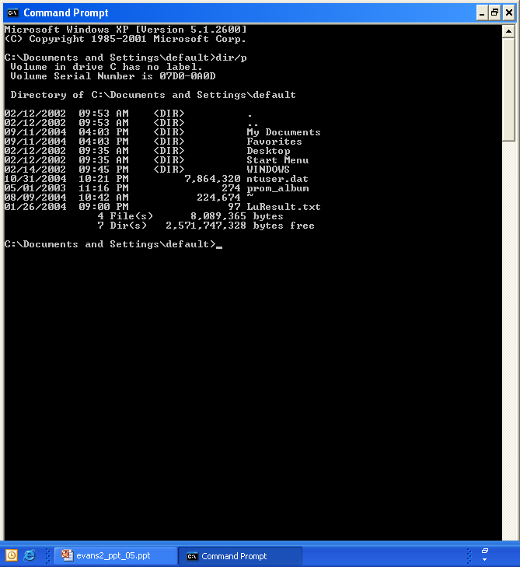
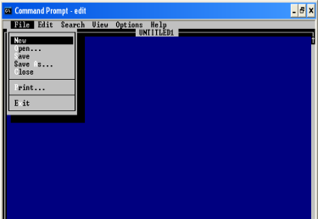
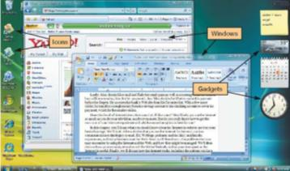
The User Interface
Enables you to interact with the computer
Types of interfaces:
Command-driven interface
Menu-driven interface
Graphical user interface (GUI)
Command-driven
Notes:
The OS provides a user interface that enables you to interact with the computer.
In early PCs, interaction with the OS was through a command-driven interface, meaning that the user had to type very specific commands to get the computer to load a program. The commands were not always easy to understand; therefore the interface proved to be too complicated for the average user.
The command-driven interface was later improved by incorporating a menu-driven interface in which the user chooses a command from menus displayed on the screen. Menu-driven interfaces eliminated the need to know every command because you could select most of the commonly used commands from a menu. However, they were still not easy enough for most people to use.
Most operating systems today use a graphical user interface. Unlike the command- and menu-driven interfaces used earlier, GUIs display graphics and use the point-and-click technology of the mouse and cursor, making operating systems much more user friendly.

Slide 14
Processor Management
Controls the timing of events the processor works on
Interrupts
Interrupt handler
Interrupt table
Stack
Notes:
Although the CPU is the brains of the computer, it needs the OS to arrange for the execution of all its activities in a systematic way.
To do so, the OS assigns a slice of its time to each activity requiring the CPU’s attention. The OS then switches between processes thousands of times a second so it appears that everything is happening seamlessly.
When the OS allows you to perform more than one task at a time, it is said to be multitasking.
The OS processes a task assigned a higher priority before processing a task that has been assigned a lower priority. This is called preemptive multitasking.
For example, assume you’re typing and you want to print a file. When you tell your computer to print the file, the printer generates a signal called an interrupt that tells the OS it is in need of attention.
Every device has its own type of interrupt, which is associated with an interrupt handler, a special numerical code that prioritizes the requests. These requests are placed in the interrupt table in RAM.
In our example, the OS pauses the CPU from its typing activity when it receives the interrupt from the printer and puts a “memo” in a special location in RAM called a stack. The memo is a reminder of where the CPU was before it left off so that it can work on the printer request.
The CPU then retrieves the printer request from the interrupt table and begins to process it. Upon completion of the printer request, the CPU goes back to the stack, retrieves the memo it placed about the typing activity, and returns to that task until it is interrupted again.

Slide 15
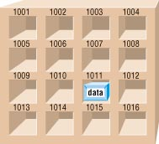
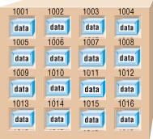

Memory and Storage Management
The operating system allocates space in RAM for instructions and data.
RAM
Operating System
Notes:
As the OS coordinates the activities of the processor, it uses RAM as a temporary storage area for instructions and data the processor needs.
The processor then accesses these instructions and data from RAM when it is ready to process them.
The OS is therefore responsible for coordinating the space allocations in RAM to ensure that there is enough space for all the waiting instructions and data.
It then clears the items from RAM when the processor no longer needs them.

Slide 16
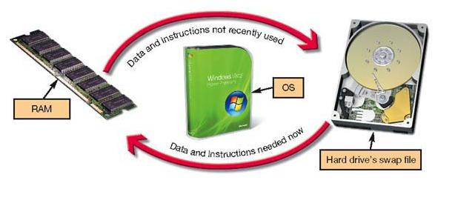
Virtual Memory
Instructions and data are stored on the hard drive when RAM is full.
Swap file
Paging
Thrashing
Notes:
RAM has limited capacity. When there isn’t enough room in RAM for the OS to store the required data and instructions, it borrows room from the hard drive.
This process of optimizing RAM storage by borrowing hard drive space is called virtual memory.
When more RAM space is needed, the OS swaps out from RAM the data or instructions that have not been recently used and moves them to a temporary storage area on the hard drive called the swap file.
If the data and/or instructions in the swap file are needed later, the OS swaps them back into active RAM and replaces them in the hard drive’s swap file with less-active data or instructions. This process of swapping is known as paging.
Eventually your computer will become sluggish as it is forced to page more and more often. This condition of excessive paging is called thrashing.
The solution to this problem is to increase the amount of RAM in your system so that it can avoid having to send data and instructions to virtual memory.

Slide 17
Hardware and Peripheral Device Management
Device drivers
Programs that enable the operating system to communicate with peripheral devices
Provided by the manufacturer of the device
Plug and Play
Hardware and software standard
Facilitates the installation of new hardware
Notes:
Each device attached to your computer comes with a special program, called a device driver, that facilitates the communication between the device and the OS.
The device driver translates the specialized commands of the device to commands that the OS can understand, and vice versa. Thus, devices will not function without the proper device driver because the OS would not know how to communicate with them.
Today, most devices come with the driver preinstalled in Windows. Devices whose drivers are included in Windows are called Plug and Play (PnP).
Plug and Play is not a driver. Instead, it is a software and hardware standard designed to facilitate the installation of a new piece of hardware in computers by including in the OS the driver the device needs to run.
Plug and Play enables users to plug their new device into a port on the system, turn on the system, and immediately use the device. The OS automatically recognizes the device and its driver.

